Slide 1
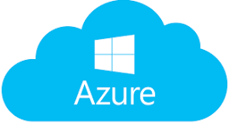
Microservices
(Azure APIM),
(12 Factor, Microservices APIs, Security, logging,Monitoring, DR, Backup, Revision), Version, Revision, Subscription, Products, Inbound, outbound Policies. Security( Subscription, Products, Oauth, Certification) Developer Portal, Apis, Apps Gateway,
Deploy Secure Azure Function & Durable function, Orchestration and event trigger, Binding, Cloud Design Pattern
Azure Services
(Compute, Storage, Security, Networking, Operation)
Networking, Firewall, Policies, Data, Storage, backup, Azure Well Architecture Framework (Reliability, Cost Optimization, Operation Excellence, Performance, Security), Azure Networking (Site to Site, Site to Point, Point to Site), Load Balacer( Azure load balancer, Azure front door, Azure Traffic Manager, Azure application gateway), Advisor, Sentinel, DDOS Protection, Blueprint,
Azure Migration
(Migration On-Premise app to Azure, Migration Strategy, 6R( Rehost, Re-platform, Repurchase, Refactor, Retain, Retire),Cloud Adaption Framework(Strategy, Plan, Ready, Adopt, Govern, Manage, Backup, DR)
Azure DevOps CICD Pipeline
(Linux Ubuntu Server Commands, Classic editor, Docker, ACR, AKS, Kubernetes Role Base Security), YAML (Node, Pod, Replicaset, Services,Deployment, Namespace, Storage, Configruation, Secret, Cluster Role, Role Binding, HPA, Node pool), Azure DevOps(classic editor, Variable group, Pipeline,
Release Pipelines to deploy across Environments (Dev,QA)

Slide 2
.NET Core
Cloud Design Pattern
Creational: Abstract Factory,Factory Method,Singleton, Prototype,Builder
Structural:Adapter,Bridge,Composite,Decorator,Facade,
Flyweight,Proxy
Behavioral: Mediator,Memento,Interpreter,Iterator,Chain of Responsibility,Command,State,Strategy,Observer, Template,Visitor
Azure Integration Services
Azure API Management
Azure Function & Durable function
Azure Logic app
Azure Event grid, Event Hub, Service Bus
Database
Azure CosmosDB, Azure SQL Server, Azure Storage (Table, Queue)

Slide 3
Task
Situation
Approach
Result

Slide 4
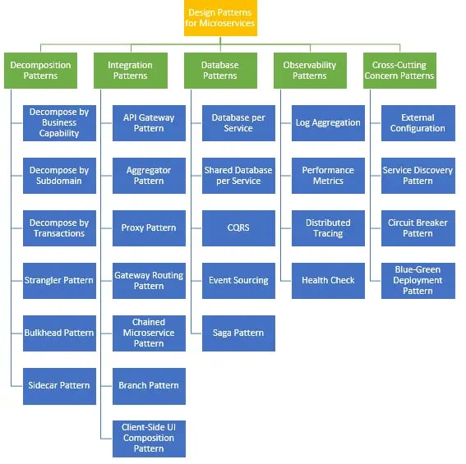
Design Pattern
Creational | Structural | Behavioral
Abstract Factory | Adapter | Mediator
Factory Method | Bridge | Memento
Singleton | Composite | Interpreter
Prototype | Decorator | Iterator
Builder | Facade | Chain of Responsibility
 | Flyweight | Command
 | Proxy | State
 |  | Strategy
 |  | Observer
 |  | Template
 |  | Visitor

Slide 5
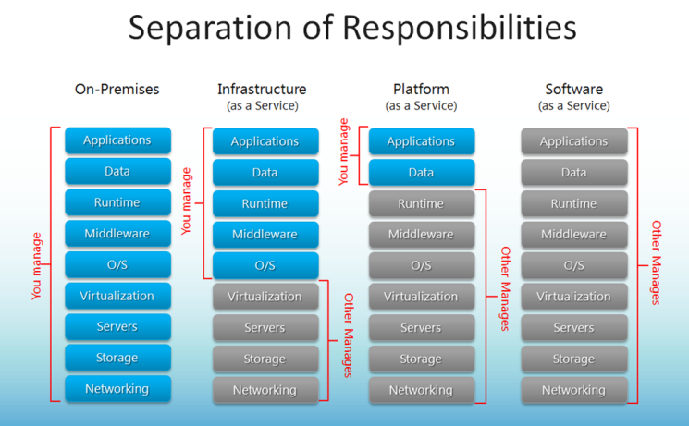

Slide 6
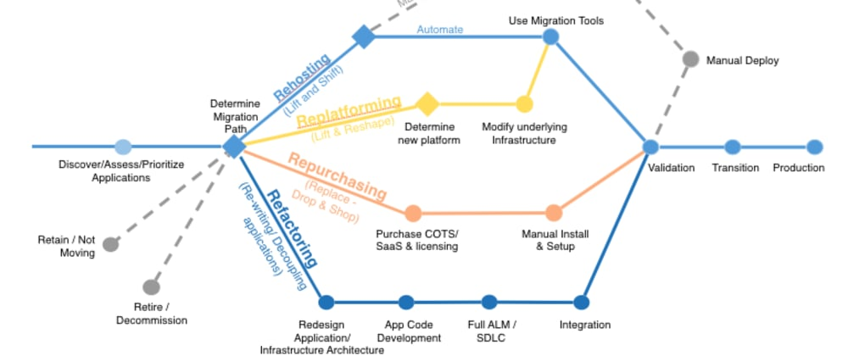

Slide 7
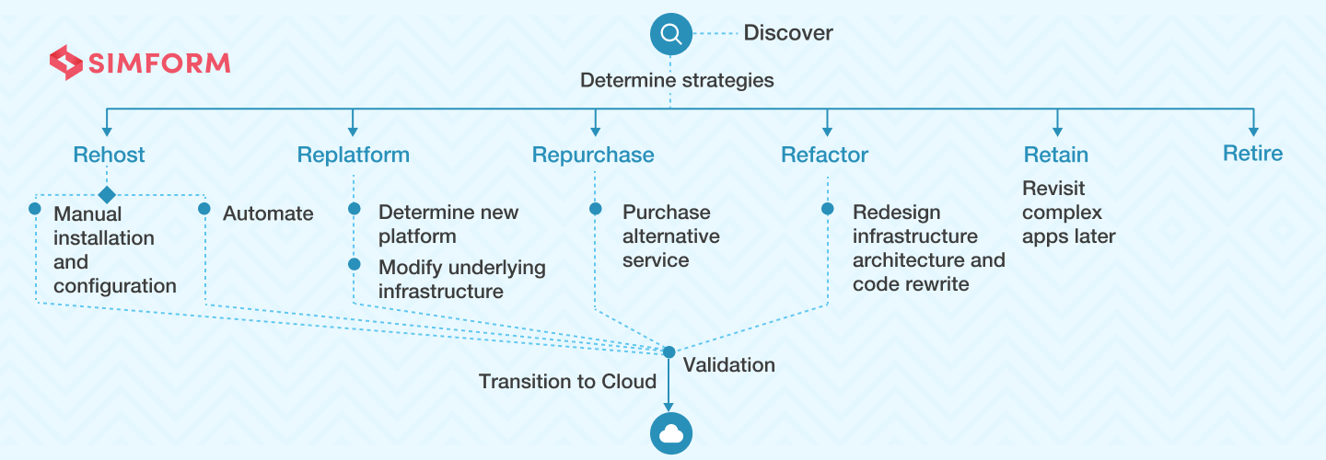

Slide 8
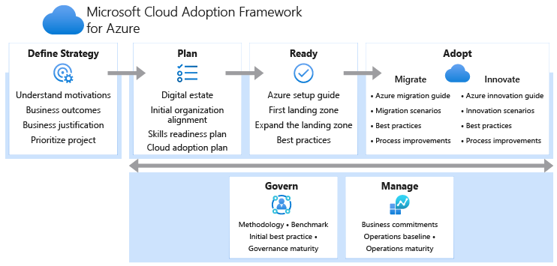

Slide 9
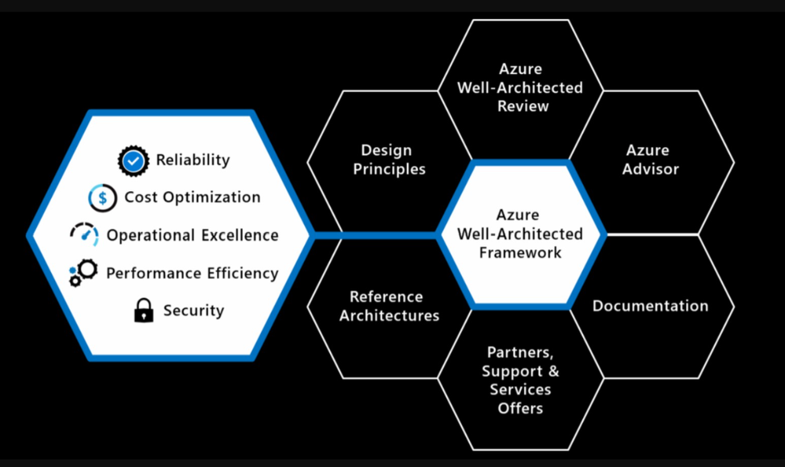

Slide 10
0. Tenant, Subscription, multiple subscription, Resource group
1. Azure Active Directory (User, Group, Role), AD Connect
- App Registration (web App, APIs)
2. Azure API Management
(Developer Portal, API Gateway, APIs)
Security – Using Certificate, OAuth, Subscription, Policies)
3. Azure Storage(Blob, File, Table, Queue, Disk)
4. Azure Event Grid (Push model)
5. Azure Event Hub
6. Azure Service Bus
7. Azure Application Insight
8. Azure Data Lake Storage
9. Azure SQL Database, SQL Server, SQL Managed Instance,
SQL Elastic Pool, SQL Virtual Machine
10. Azure Cosmos DB
11. Azure Backup, Azure Site Recovery
12. Azure CDN
13. Azure Data Factory
14. Azure Virtual Machine
15. Azure Monitor
16. Azure Sentinel
17. Azure DNS
18. Azure Networking (VNET, Subnet, NSG, ASG), Bastion
19. Azure Key Vault
20. Azure VM, VM Scale set
21. Azure Security Center
22. Azure Blueprint
23. Azure Policy
24. Azure Private End point, Public end point
25. Azure Log Analytics workspace
26. Azure Data Factory
27. Azure Function, Durable function(statefull, Stateless)-Function chaining, fan out fan in, long running job,Human Interaction, external Event Correlation)
Orchestration event, Triggered Event
28. Azure Traffic Manager, azure application Gateway, Azure Front Door, Azure Load Balancer
29. Azure Web App
30. Azure Site Recovery
31. Azure Database Migration Service
32. Blue Green Deployment ,

Slide 11
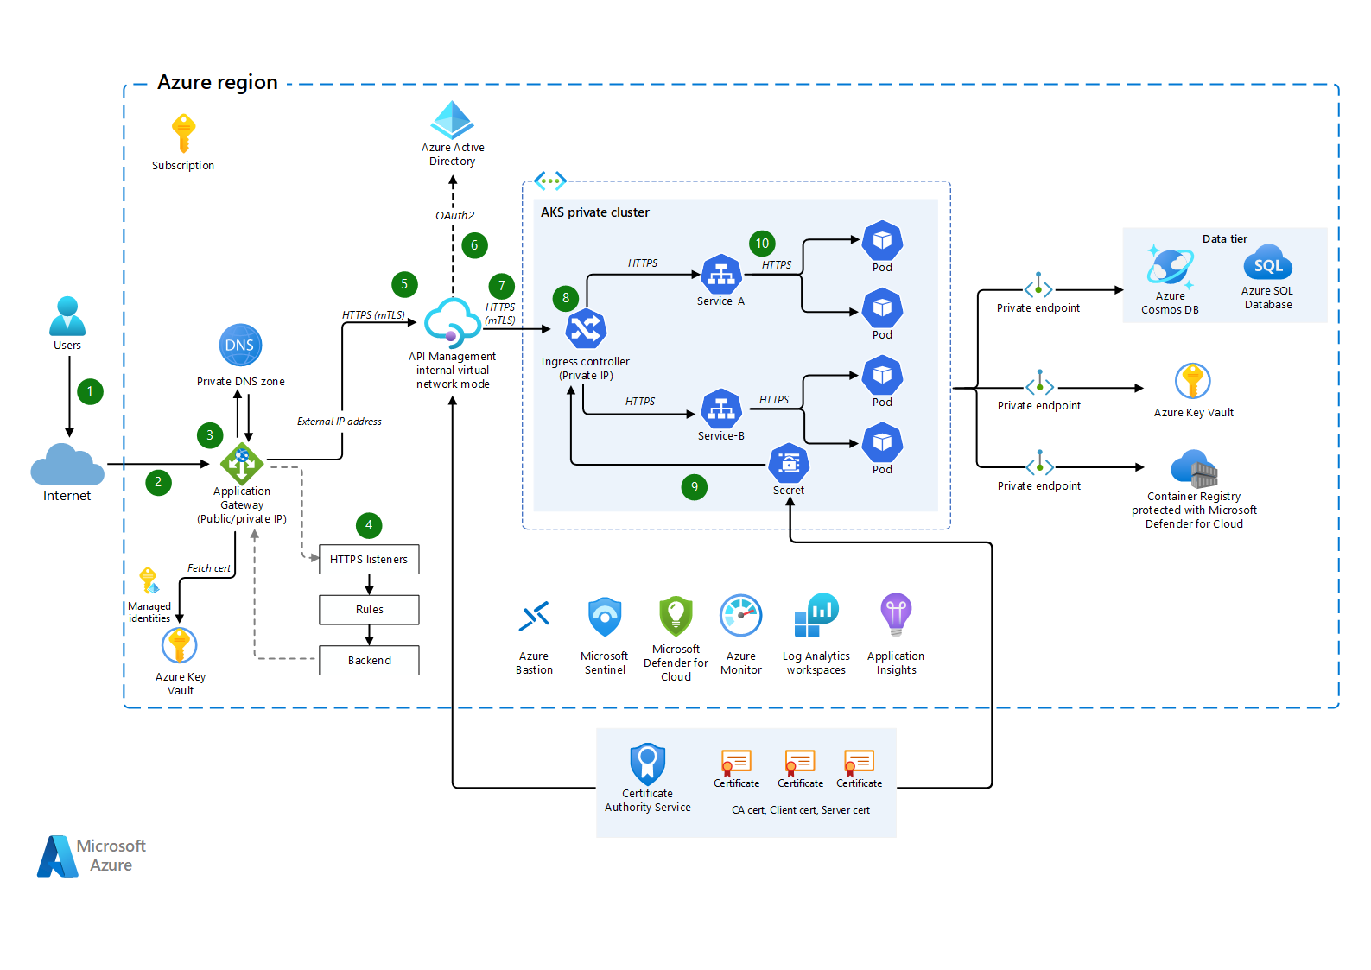
Azure API Management

Slide 12
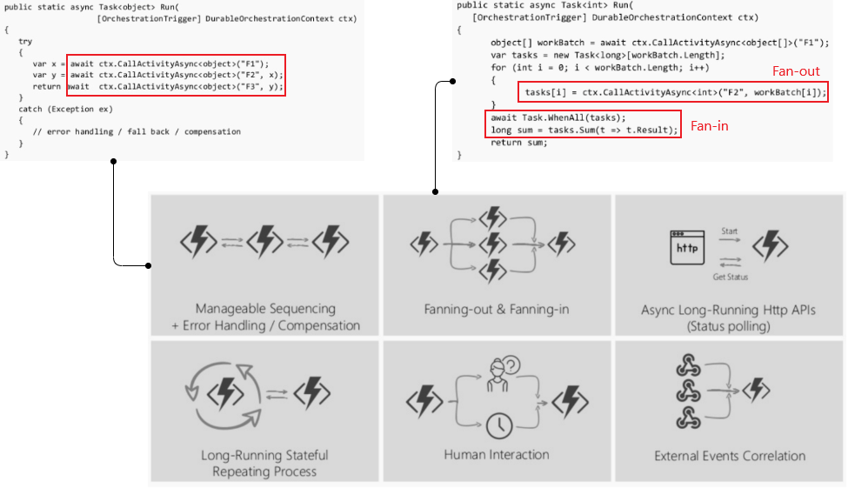
Azure Durable Function

Slide 13
Design Pattern
Creational | Structural | Behavioral
Abstract Factory | Adapter | Mediator
Factory Method | Bridge | Memento
Singleton | Composite | Interpreter
Prototype | Decorator | Iterator
Builder | Facade | Chain of Responsibility
 | Flyweight | Command
 | Proxy | State
 |  | Strategy
 |  | Observer
 |  | Template
 |  | Visitor

Slide 14
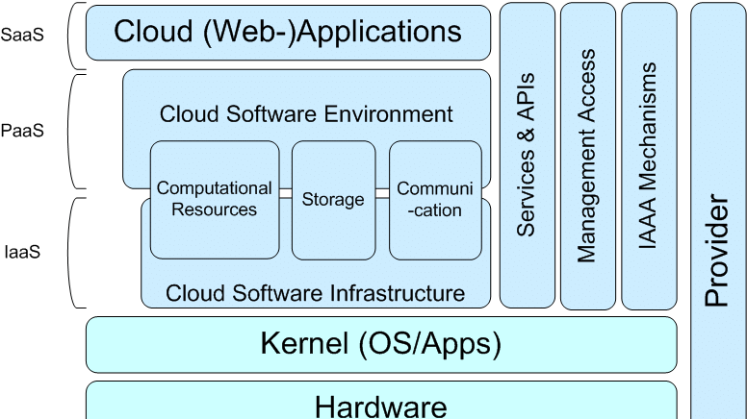

Slide 15
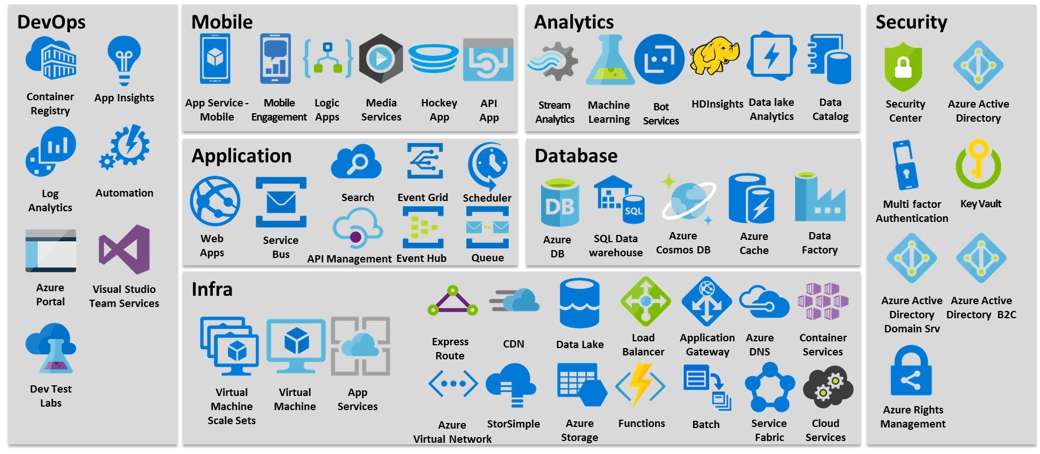

Slide 16









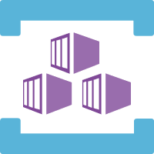





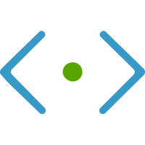


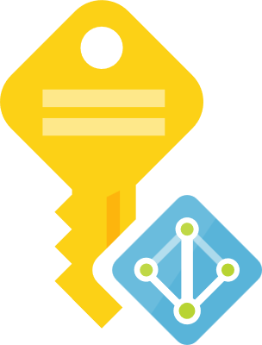
Azure Services Integrated with AKS
Azure
Disks
Azure
Public IP
Azure
AD
Azure
Container
Registry
Azure
Kubernetes
Service
Standard
Load
Balancer
AD
Groups
AKS
Linux & Windows
Nodepools
Azure
MySQL
Azure
DevOps
Azure
Files
Virtual
Network
AD
Users
Azure
Build & Release
Pipelines
Azure
VM
ScaleSets
Azure
DNS
Zones
Azure
Managed
Service
Identity
Storage
Account
Azure
Container Instances
Virtual Nodes
Subnets

Slide 17
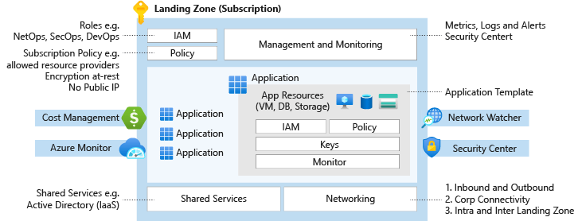

Slide 18
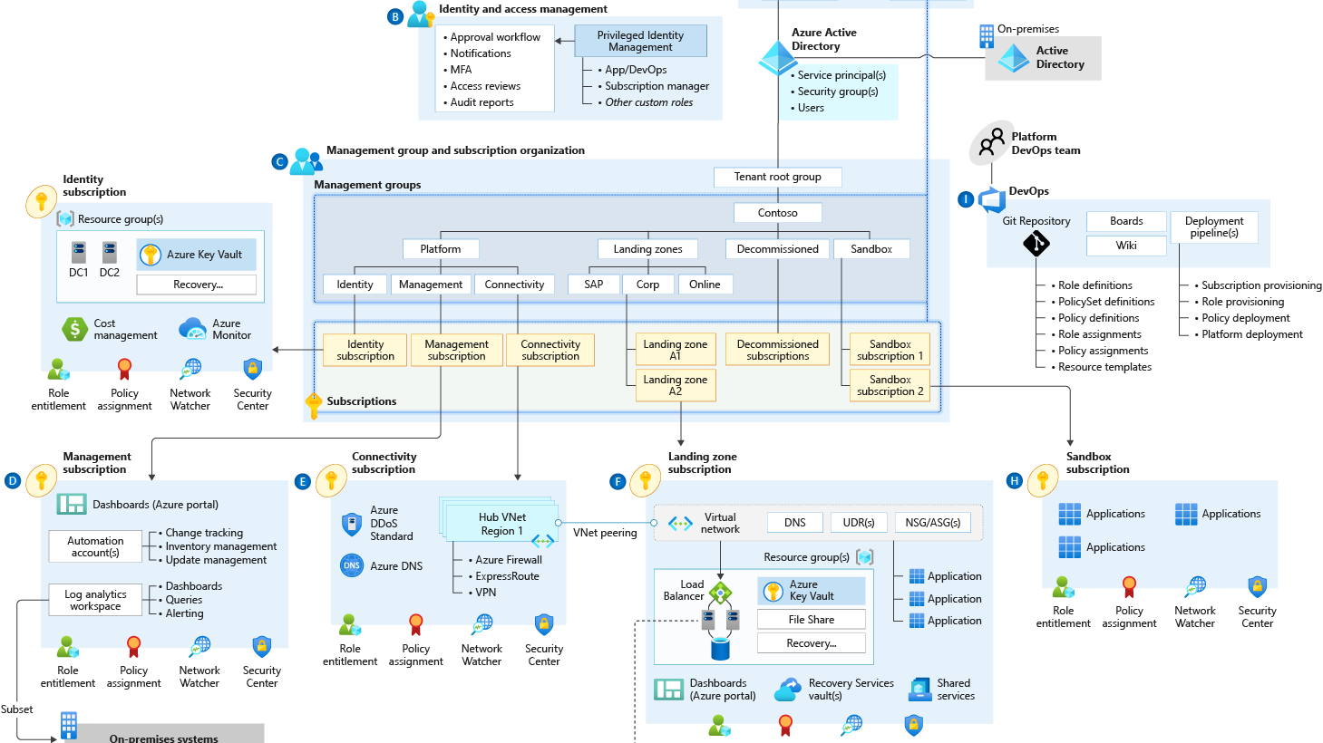

Slide 19
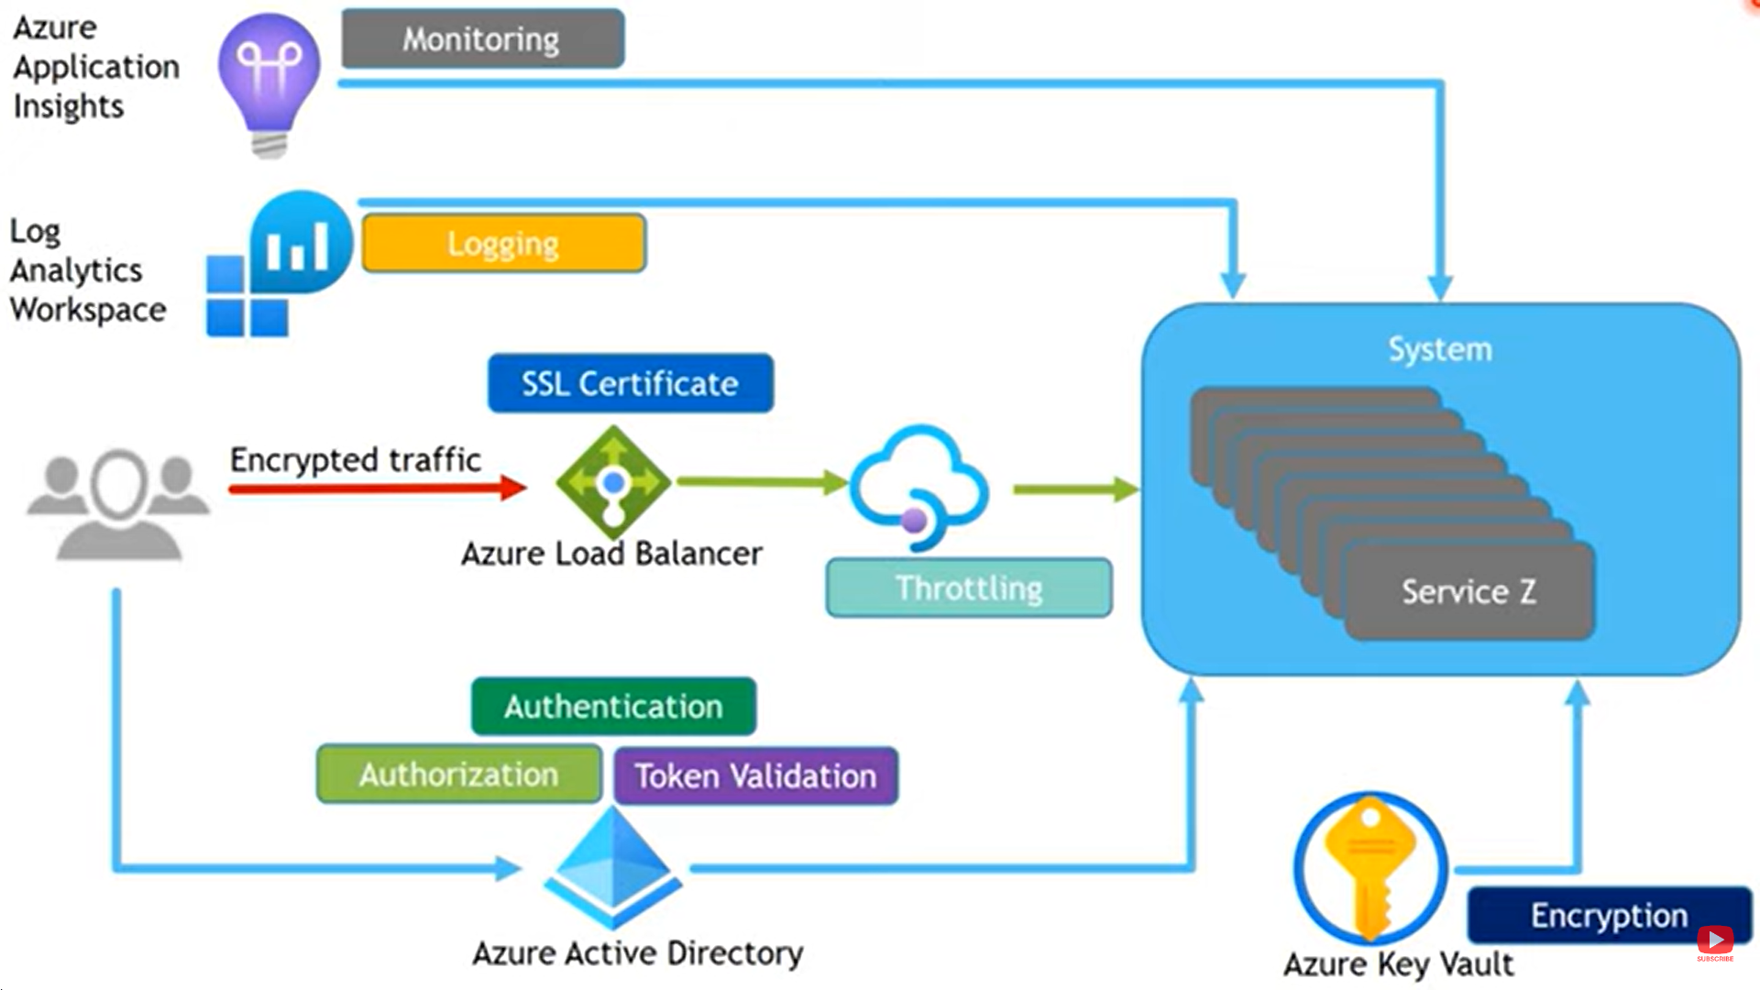
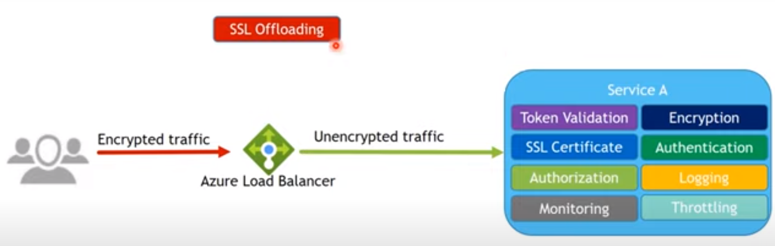

Slide 20
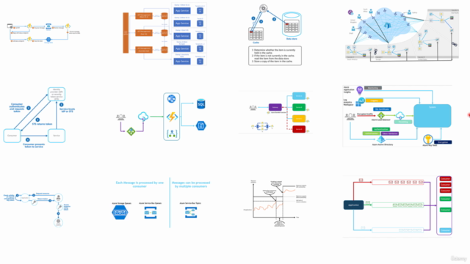
Overview

Slide 21
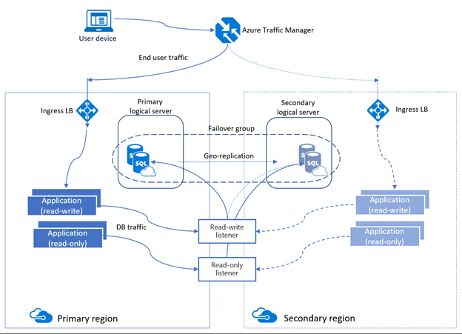

Slide 22
Reference Architecture (Example)
Billing Service (Azure function, Azure Table storage)
Azure API Management (Security, logging, Monitoring, API Communication)
Migrate Monolith web app and SQL Server on Azure (High available and scalable architecture)
High available Scalable and performance using Load balancer, web app, Redis, NOSQL, CDN, Search etc.

Slide 23
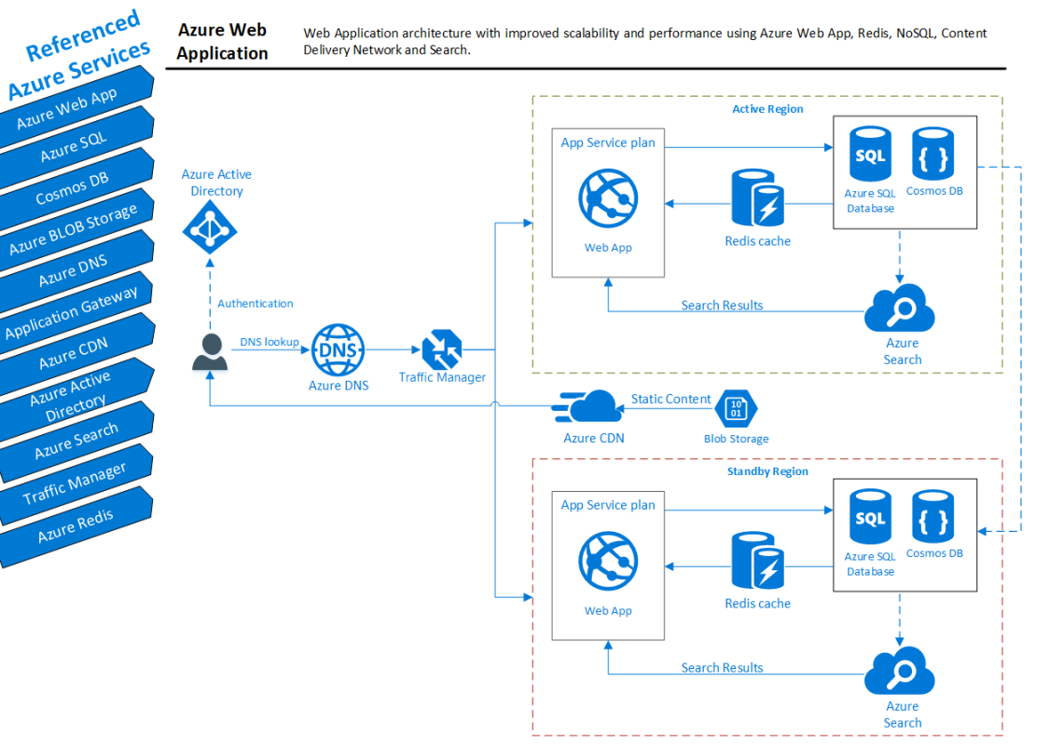

Slide 24
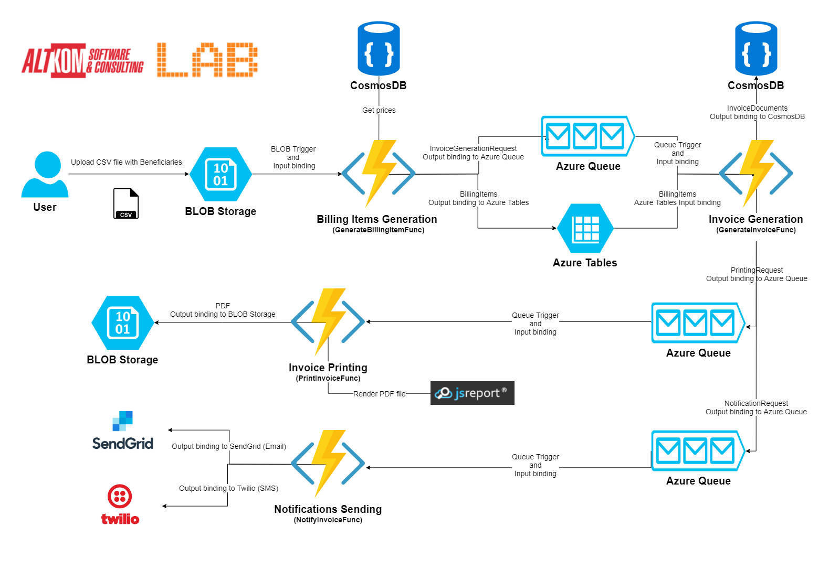

Slide 25
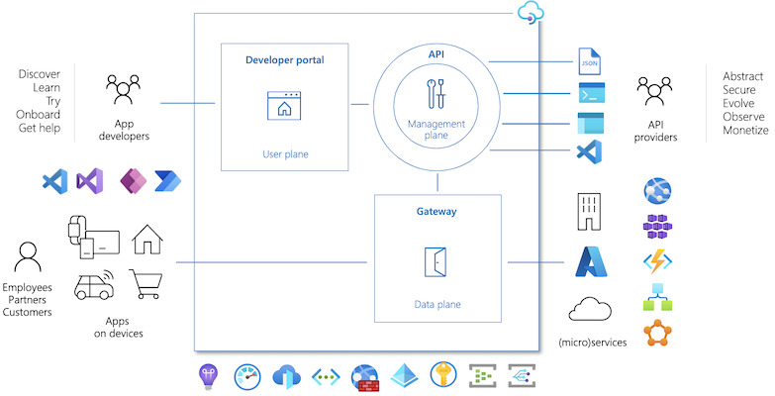

Slide 26
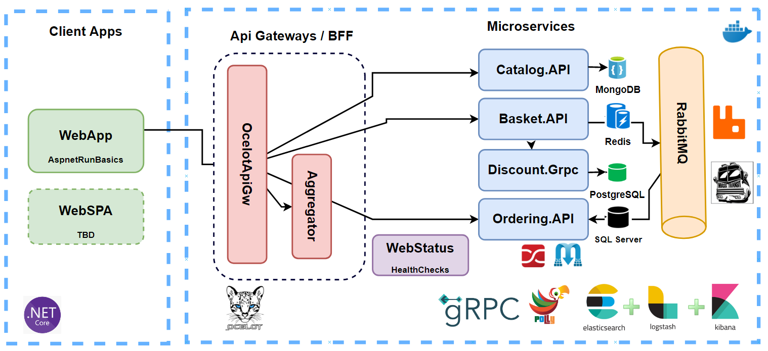

Slide 27
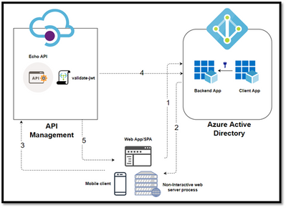
Protect API's using OAuth 2.0 in APIM

Slide 28
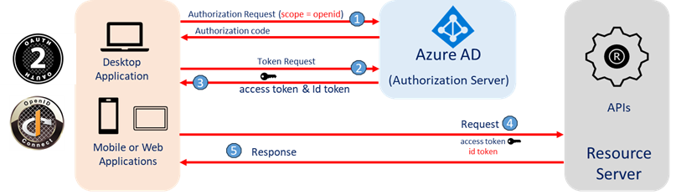
OpenID Connect (OIDC) with Azure AD

Slide 29
Azure DevOps

Slide 30
Docker - Fundamentals
nginxdemos/hello
Docker Daemon
Docker Registry
(Docker Hub)
nginxdemos/hello
Container-11
Images
Containers
Docker Host
docker pull nginxdemos/hello
Docker Registry or Docker Hub
A Docker registry stores Docker images.
Docker Hub is a public registry that anyone can use, and Docker is configured to look for images on Docker Hub by default.
We can even run our own private registry.
When we use the docker pull or docker run commands, the required images are pulled from our configured registry.
When we use the docker push command, our image is pushed to our configured registry.
docker run -p 82:80 -d nginxdemos/hello
Docker Client (My Desktop or Docker Host)

Slide 31
Kubernetes - Imperative & Declarative
Kubernetes Fundamentals
Imperative
Declarative
kubectl
YAML & kubectl
Pod
Pod
ReplicaSet
ReplicaSet
Deployment
Deployment
Service
Service

Slide 32

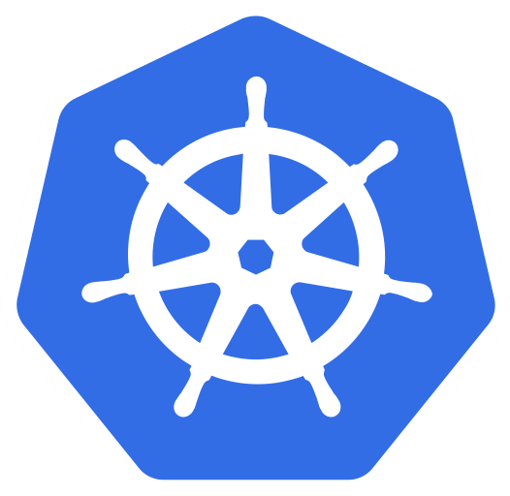
Azure AKS Cluster
http://<External-IP-from-get-service-output>
UserMgmt – LoadBalancer Service
Users
Load Balancer Service
Deployment
Web
App
Environment Variables
POD
ReplicaSet
Init Containers
Azure Disks
Deployment (UserMgmt)
MySQL – ClusterIP Service
Config Map
Storage Class
Environment Variables
Persistent Volume Claim
Volumes
MySql
AKS Storage Azure Disks
Persistent Volumes
Volume Mounts
POD
ReplicaSet
Deployment
Deployment (mysql)
ClusterIP Service

Slide 33
Azure AKS Cluster
http://<External-IP-from-get-service-output>
UserMgmt – LoadBalancer Service
Users
Load Balancer Service
Deployment
Web
App
Environment Variables
POD
ReplicaSet
Init Containers
Deployment (UserMgmt)
MySQL – ExternalName Service
High Availability
Monitoring & Alerting
AKS Storage Azure MySQL Database
Backup & Recovery
Automatic Upgrades
Read Replicas
Azure MySQL
Database
Secure Data at rest and motion

Slide 34
http://<External-IP-from-get-service-output>/app1/file1.html
Azure AKS Cluster
LoadBalancer Service
Users
Load Balancer Service
AKS Storage Azure Files
Deployment
NGINX
NGINX
NGINX
POD
POD
POD
Volumes
ReplicaSet
Deployment
Volume Mounts
Storage Class
Key Advantage with Azure File Shares:
Multiple pods can access the single file share
Azure Storage Account
Persistent Volume Claim
file1.html
file2.html
Persistent Volumes
</>
HTML
</>
HTML
Azure File Shares

Slide 35
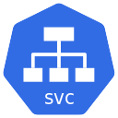




Azure AKS & Nginx Ingress – Context Path Based Routing
Azure
Azure AKS Cluster
Nginx App1
/app1/
/app2/
/
Ingress Service
Nginx App2
Users
Public IP
for Ingress
Controller
Ingress Controller
AKS
Load Balancer
Usermgmt WebApp

Slide 36


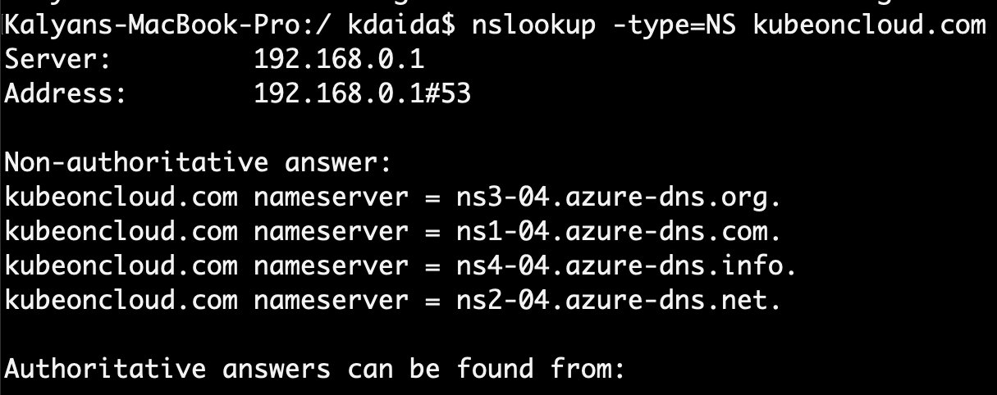
Delegate Domain to Azure DNS
AWS Cloud
Azure Cloud
DNZ Zones
Domain Registrar
kubeoncloud.com
kubeoncloud.com
AWS Route53
Azure DNS Zones

Slide 37
Azure AKS Nginx Ingress Hostname based Routing External DNS
Azure
Azure AKS Cluster
Virtual Machine
Scale Sets
DNS
Zones
Managed
Service
Identity
Nginx App1
External DNS
eapp1.kubeoncloud.com
eapp2.kubeoncloud.com
eapp3.kubeoncloud.com
Nginx App2
Ingress Service
Users
Public IP
for Ingress
Controller
Ingress Controller
AKS
Load Balancer
Usermgmt WebApp

Slide 38

Azure AKS Nginx Ingress External DNS SSL with Lets Encrypt
Azure
Azure AKS Cluster
Virtual Machine
Scale Sets
External DNS
DNS
Zones
Managed
Service
Identity
cert-manager
sapp1.kubeoncloud.com
sapp2.kubeoncloud.com
Nginx App1
Ingress Service
Users
Public IP
for Ingress
Controller
Ingress Controller
AKS
Load Balancer
Nginx App2

Slide 39
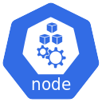
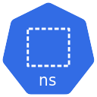
Kubernetes – Requests & Limits
K8s cluster
K8s Node
default namespace
CPU: 8 vcores
(8000m)
Container-1
Container-2
Memory: 32GB
CPU: 500m
CPU: 1000m
CPU: 500m
CPU: 1000m
Mem: 128Mi
Mem: 500Mi
Mem: 128Mi
Mem: 500Mi
Requests
Limits
Requests
Limits

Slide 40
Kubernetes - Namespaces & DNS
K8s cluster
K8s Node
default namespace
dev namespace
qa namespace
App1
App1
App1
app1.default.svc.cluster.local
app1.dev.svc.cluster.local
app1.qa.svc.cluster.local
<service-name>.<namespace-name>.svc.cluster.local

Slide 41
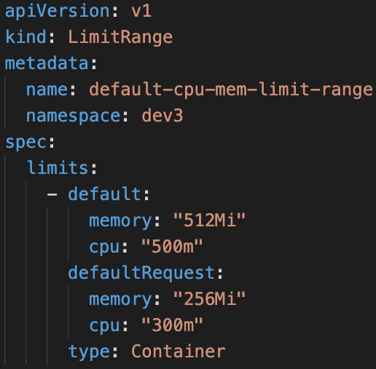
Limit Range
LoadBalancer Service
LoadBalancer Service
LoadBalancer Service
F
F
F
Pod
Pod
Pod
Limit Range Manifest
ReplicaSet
ReplicaSet
ReplicaSet
Deployment
Deployment
Deployment
ClusterIP Service
ClusterIP Service
ClusterIP Service
B
B
B
Pod
Pod
Pod
ReplicaSet
ReplicaSet
ReplicaSet
Deployment
Deployment
Deployment
Deployment
CPU
Memory
CPU
Memory
CPU
Memory
default
Min/Max
default
Min/Max
default
Min/Max
Limit Range (Per Container)
Limit Range (Per Container)
Limit Range (Per Container)
Namespace: dev
Namespace: qa
Namespace: staging

Slide 42
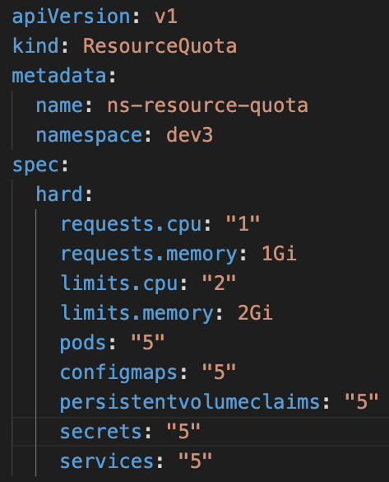
Resource Quota
LoadBalancer Service
LoadBalancer Service
LoadBalancer Service
F
F
F
Resource Quota Manifest
Pod
Pod
Pod
ReplicaSet
ReplicaSet
ReplicaSet
Deployment
Deployment
Deployment
ClusterIP Service
ClusterIP Service
ClusterIP Service
B
B
B
Pod
Pod
Pod
ReplicaSet
ReplicaSet
ReplicaSet
Deployment
Deployment
Deployment
Deployment
CPU
Memory
CPU
Memory
CPU
Memory
Pods
Services
Pods
Services
Pods
Services
Resource Quota
Resource Quota
Resource Quota
Namespace: dev
Namespace: qa
Namespace: staging

Slide 43
Azure AKS Virtual Nodes
Virtual Kubelet
Azure Container Instances
ACI
Azure Virtual Nodes on
AKS
+
=

Slide 44
Azure AKS - Virtual Nodes
Azure Cloud
Azure AKS Cluster
VNET1
AKS Cluster
Control Plane
Node Pool
Virtual Nodes
Azure Container Instance - ACI
Subnet: default
Subnet: virtual-node-aci

Slide 45
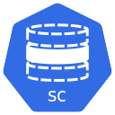
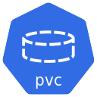
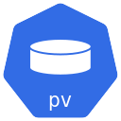
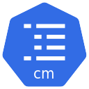
Azure AKS - Virtual Nodes Mixed Mode Deployments
Azure Cloud
Azure AKS Cluster
VNET1
MySQL Cluster IP Service
UserMgmt LoadBalancer Service
MySQL Pod
Usermgmt Pod
Virtual Node
AKS Worker Node
Node Pool
Azure Container Instance - ACI
Subnet: default
AKS Cluster
Control Plane
Subnet: virtual-node-aci
Azure Disks

Slide 46

Azure ACR and AKS - Integration
Docker Developer
Azure Cloud
Azure Container
Registry
Azure AKS Cluster
Build and Push
Docker Image
Integrate ACR and AKS
Azure AKS Cluster
Control Plane
Pull Docker Image from ACR
http://<public-ip>
Users
Public IP
App1 LB
Nginx App1
AKS
Load Balancer

Slide 47
Pull Docker Images from ACR using Service Principal
Run on Azure AKS Nodepools
Docker Developer
Azure Cloud
Azure Container
Registry
Azure AKS Cluster
Build and Push
Docker Image
Azure AKS Cluster
Control Plane
Pull Docker Image from ACR
docker-server
docker-username
http://<public-ip>
docker-password
Users
Public IP
App1 LB
Nginx App1
AKS
Load Balancer

Slide 48
Pull Docker Images from ACR using Service Principal
Run on Azure Virtual Nodes
Docker Developer
Azure Cloud
Azure Container
Registry
Azure AKS Cluster
Azure AKS Cluster
Control Plane
Build and Push
Docker Image
Pull Docker Image from ACR
docker-server
docker-username
docker-password
http://<public-ip>
Nginx App1
Users
Public IP
App1 LB
Virtual Node - ACI
AKS
Load Balancer

Slide 49
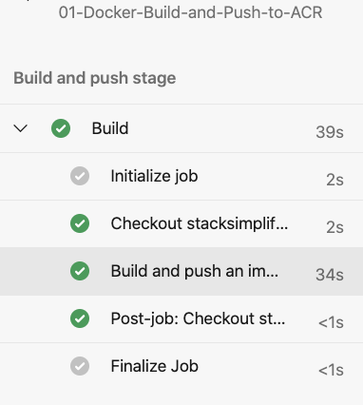
Azure DevOps Pipelines – Build & Push Docker Image to ACR
Azure Cloud
Azure DevOps
Github
Azure Pipelines
(Build & Push)
Azure Container Registry
Developer

Slide 50
Azure DevOps – Build & Push Docker Image to ACR & Deploy to AKS
Azure DevOps
Azure Cloud
Developer
Azure Pipelines
1
2
Stage-1: Build & Push to ACR
4
Stage-2: Deploy to AKS
Github
5
Azure AKS Cluster
3
default namespace
Nginx App1
6
Azure Container Registry

Slide 51
Azure Pipelines – Key Concepts
Pipeline
Stages
Steps
Trigger
Stage-1: Build
Agent
Step-1: script: echo Hello, world!
Job
Stage-2: AA
Step-2: Task-1: Docker Build & Push to ACR
Github
Agent
Stage-3: BB
Job
Step-3: Task-2: Copy Files to Build Artifact Directory
Stage-4: CC
Job
Step-4: Task-3: Publish Artifacts to Azure Pipelines
Developer

Slide 52
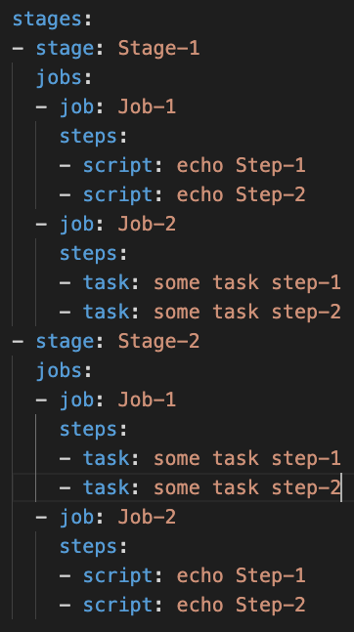
Azure Pipelines – Key Concepts
Stages
Stage-1
Jobs
Job-1
Steps
Step-1: Script
Step-2: Task
Job-2
Steps
Step-1: Task
Step-2: Task
Stage-2
Jobs
Job-1
Steps
Step-1: Script
Step-2: Script
Job-2
Steps
Step-1: Task
Step-2: Task

Slide 53

Azure Pipelines – Starter Pipeline
Goal
Create a Pipeline that will build docker images, push them to Azure Container Registry and Publish Kubernetes Manifests to Azure Pipelines
Part-1
Semi Customized
Part-2
Fully Customized using Starter Pipeline
Task-1
Use pre-defined Docker Build & Push Pipeline
Task-1
Start using Starter pipeline and use Docker Build or Push Docker Images Task
Task-2
Customize Pipeline to Use Copy Files Task
Task-2
Customize Pipeline to Use Copy Files Task
Task-3
Customize Pipeline to Use Publish Build Artifacts Task
Task-3
Customize Pipeline to Use Publish Build Artifacts Task

Slide 54
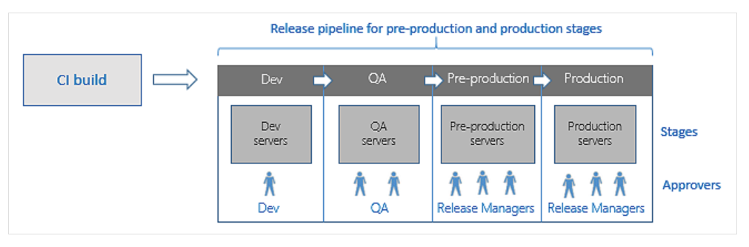
Azure DevOps – Release Pipelines
To achieve Continuous Delivery we use Release Pipelines

Slide 55
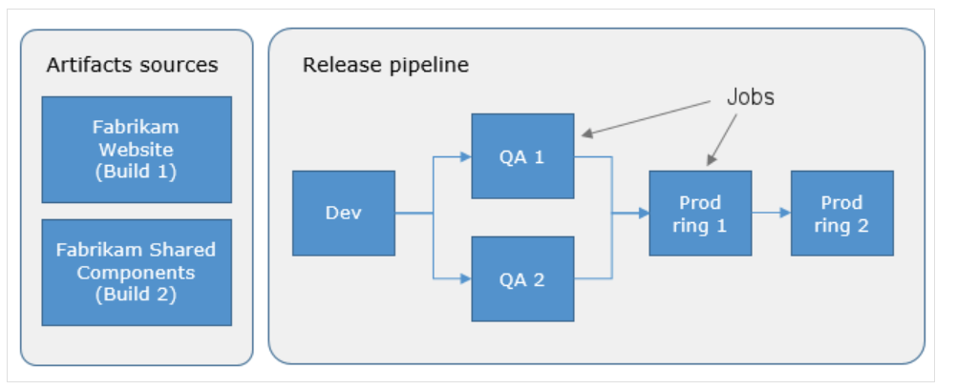
Azure DevOps – Release Pipelines

Slide 56



Developer
Github
Azure DevOps – Release Pipelines
1
2
Azure Cloud
Azure DevOps
Release Pipelines
QA
Azure Pipelines
7
Stage-1: Build & Push to ACR
4
Dev
Staging
12
Prod
3
10
Azure Container Registry
6
5
9
8
Azure AKS Cluster
12
11
14
13
dev namespace
qa namespace
Staging namespace
prod namespace
Nginx App1
Nginx App1
Nginx App1
Nginx App1

Slide 57
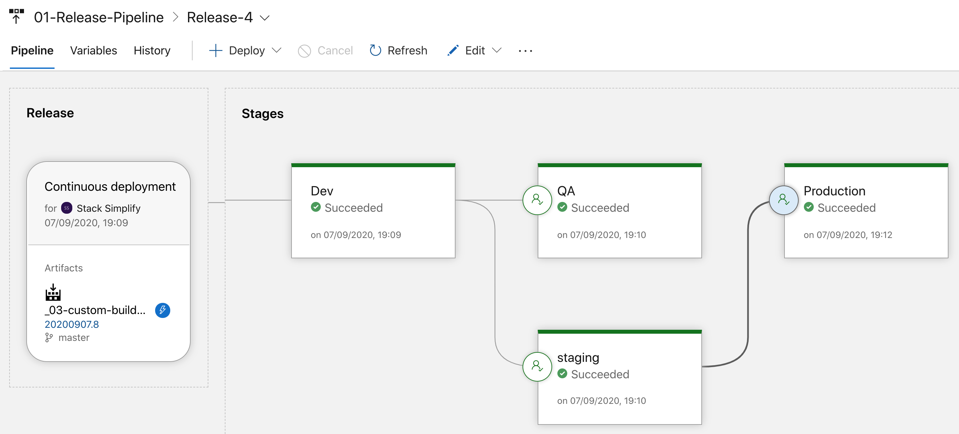
Azure Release Pipelines

Slide 58
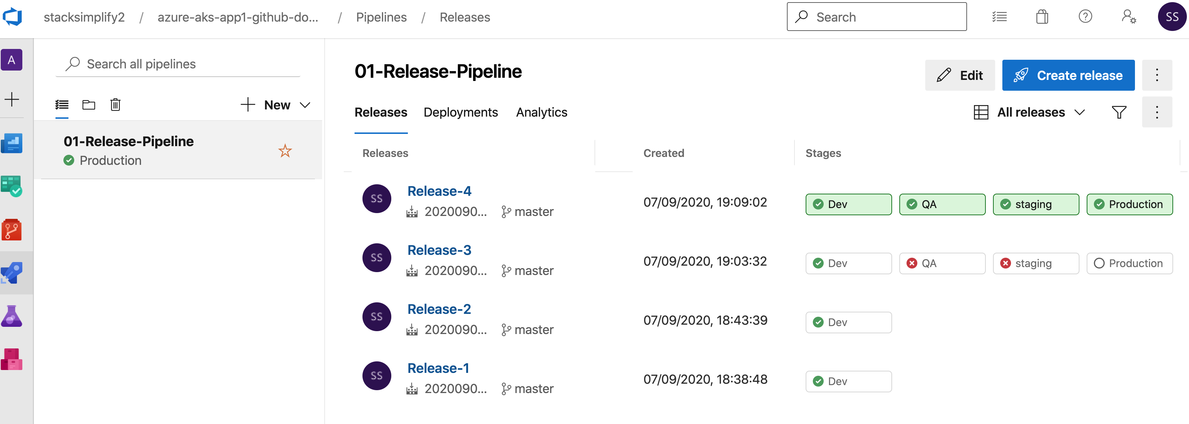
Azure Release Pipelines - Releases

Slide 59
Azure AKS HTTP Application Routing Add On Ingress + External DNS (Automatic Install)
Azure Cloud
Azure AKS Cluster
app1.7b8803340f38495c8402.centralus.aksapp.io
7b8803340f38495c8402.centralus.aksapp.io
DNS Zones
Nginx App1
External DNS
app1.7b8803340f38495c8402.centralus.aksapp.io
app1.7b8803340f38495c8402.centralus.aksapp.io
Users
Public IP
for Ingress
Controller
Ingress Controller
Ingress Service
AKS
Load Balancer
HTTP Application Routing Add On

Slide 60
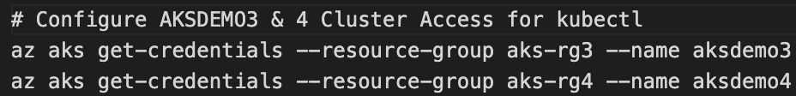
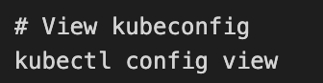

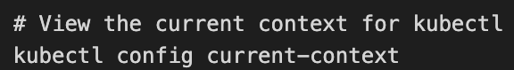
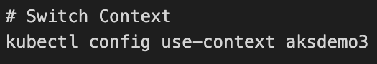
Azure AKS Cluster Access
AKS Cluster - 1
AKS Cluster-1
kubectl
Current Context
AKS Admin
AKS Cluster-2
AKS Cluster - 2

Slide 61
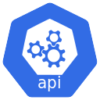


Azure Active Directory Authentication for AKS Admins
Integrate Azure AD and AKS Cluster
Azure Active Directory
Azure AKS Cluster
Azure AD Group: k8sadmins
Your Desktop
kubectl
K8S API Server
Azure AD User: user1aksadmin
Terminal

Slide 62

Azure Active Directory Authentication for AKS Admins
Authentication
Your Desktop
Azure AKS Cluster
Terminal
2
Browser
1
kubectl get nodes
Azure Active Directory
4
3
Credentials Cached
Azure AD User: user1aksadmin
K8S API Server
Azure AD Group: k8sadmins

Slide 63
Kubernetes RBAC
Kubernetes RBAC - Fundamentals
Subjects
API Groups
Resources
Verbs
Users or processes that need access to the Kubernetes API
The k8s API objects that we grant access to
List of actions that can be taken on a resource
Kind: Group, User
core
Pods
Create
Patch
Kind: Service Account
extensions
Deployments
List
get
apps
Services
Watch
Replace
batch
StatefulSets
Delete
Read
Reference: https://kubernetes.io/docs/reference/generated/kubernetes-api/v1.19

Slide 64

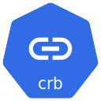
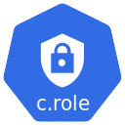


Kubernetes RBAC
Kubernetes Cluster RBAC
Cluster Role Binding
Cluster Role
Namespace: DEV
Namespace: QA
User / Group
(Subject)
Create
(Verb)
Role Binding
Role Binding
Role
Role
User / Group
(Subject)
Create
(Verb)
Pod
(Resource)
User / Group
(Subject)
Create
(Verb)
Pod
(Resource)

Slide 65
Azure Active Directory & Kubernetes RBAC
Azure AKS Kubernetes Cluster
Namespace: DEV
Namespace: QA
Role Binding
Role Binding
Role
Role
User / Group
(Subject)
Create
(Verb)
Pod
(Resource)
User / Group
(Subject)
Create
(Verb)
Pod
(Resource)
Azure AD Group: devaksteam
Azure AD User: aksdev1
Azure Active Directory
Object ID: e6dcdae4-e9ff-4261-81e6-0d08537c4cf8

Slide 66
Azure Active Directory & Kubernetes RBAC
Authentication
k8s Role
k8s Role Binding
Azure AKS Kubernetes Cluster
Namespace: DEV
Role Binding
Azure Active Directory
Role
Integrate Azure AD Group & Kubernetes RBAC
User / Group
(Subject)
get
(Verb)
Pod
(Resource)
Azure AD Group: devaksteam
Credentials Cached
5
Object ID: e6dcdae4-e9ff-42
61-81e6-0d08537c4cf8
3
Access
Granted
kubectl get pods -n dev
4
2
1
Azure AD User: aksdev1
Terminal
Your Desktop

Slide 67
Azure Active Directory & Kubernetes RBAC
Authentication
Azure AKS Kubernetes Cluster
k8s Role
k8s Role Binding
Namespace: DEV
Role Binding
Azure Active Directory
Role
Integrate Azure AD Group & Kubernetes RBAC
User / Group
(Subject)
get
(Verb)
Pod
(Resource)
Azure AD Group: devaksteam
Credentials Cached
Object ID: e6dcdae4-e9ff-42
61-81e6-0d08537c4cf8
3
Namespace: QA
kubectl get pods -n qa
Role Binding
2
Role
1
4
Access
Denied
User / Group
(Subject)
get
(Verb)
Pod
(Resource)
Azure AD User: aksdev1
Terminal
Your Desktop

Slide 68

Azure Active Directory & Kubernetes RBAC
Authentication
k8s Cluster Role
Azure AKS Kubernetes Cluster
Cluster Role Binding
k8s Cluster Role Binding
Azure Active Directory
Cluster Role
Integrate Azure AD Group & Kubernetes RBAC
User / Group
(Subject)
Get
(Verb)
Azure AD Group: aksreadonly
Access
Granted
(Resources)
Object ID: e6dcdae4-e9ff-42
61-81e6-0d08537c4cf8
4
3
Credentials Cached
kubectl get nodes
1
2
Read Only User
Terminal
Azure AD User: aksread1
Your Desktop

Slide 69
Azure Active Directory & Kubernetes RBAC
Authentication
k8s Cluster Role
Azure AKS Kubernetes Cluster
Cluster Role Binding
k8s Cluster Role Binding
Azure Active Directory
Cluster Role
Integrate Azure AD Group & Kubernetes RBAC
User / Group
(Subject)
Get
(Verb)
Azure AD Group: aksreadonly
Access
Denied
(Resources)
Object ID: e6dcdae4-e9ff-42
61-81e6-0d08537c4cf8
4
3
Credentials Cached
kubectl create ns dev
1
2
Read Only User
Terminal
Azure AD User: aksread1
Your Desktop

Slide 70

Azure AKS – Autoscaling Nodes & Pods
Azure Kubernetes Service (AKS) Cluster
Automatically auto-scale nodes
Cluster Autoscaler
Scale out
Automatically auto-scale pods
Horizontal Pod Autoscaler
Scale out

Slide 71
System Node Pools
User Node Pools
Virtual Nodes
System Assigned Managed Identity
Kubernetes RBAC
AKS Managed Azure AD
Node Pools
Authentication
Container Registry
Azure CNI
Azure AKS
Cluster
Azure Monitor
Integrations
Load Balancer Standard
Networking
Basics
Azure Policy
Public Cluster
(Restrict Access) / Private
Region
Kubernetes
Version
Zones

Slide 72
Azure AKS
Cluster
Basics
Node Pools
Authentication
Networking
Integrations
Additional
Regions
System Node Pools
System Assigned Managed Identity
Azure CNI
Container Registry
Virtual Network
User Node Pools
Default Subnet
Kubernetes
Version
(Default)
Kubernetes RBAC
(default enabled)
Load Balancer Standard
Azure Monitor
Virtual Nodes
Virtual Nodes Subnet
Zones
AKS Managed Azure AD
Public Cluster
(Restrict Access) / Private
Azure Policy
Windows Node Pools
SSH Public Key

Slide 73
Section-1
Create AKS Cluster
Section-2
Create Windows, Linux User Node Pools and Virtual Nodes
Section-3
Deploy Apps to all 4 node pools using Kubernetes Node Selector concept

Slide 74





Azure AKS Cluster – Create AKS Cluster using CLI
Azure Cloud
VNET
Default Subnet: 10.240.0.0/16
Load Balancer
System Node Pool: Linux
kubectl
Azure AKS
Cluster Control Plane
Public IP
Virtual Nodes Subnet: 10.241.0.0/16
AKS AdminUser

Slide 75
Azure AKS Cluster – Node Pools (Linux, Windows, Virtual)
Azure Cloud
VNET
Default Subnet: 10.240.0.0/16
Load Balancer
System Node Pool: Linux
kubectl
Azure AKS
Cluster Control Plane
User Node Pool: Linux
Public IP
Virtual Nodes Subnet: 10.241.0.0/16
Azure Container Instances - ACI
User Node Pool: Windows
Virtual Node
AKS AdminUser

Slide 76





Azure Cloud
VNET
AKS Admin
K8s API Server Public IP
Default Subnet: 10.240.0.0/16
AKS
Cluster Control Plane
System Node Pool: Linux
App1
Azure Active
Directory
kubectl
App1 Public IP
User Node Pool: Linux
App2
App2 Public IP
User Node Pool: Windows
App3
App3 Public IP
Load Balancer
Virtual Nodes Subnet: 10.241.0.0/16
App4 Public IP
ACI Virtual Nodes
App4
Deploy Apps to different NodePools using
Kubernetes Node Selector Concept on Azure AKS
K8S Service CIDR: 10.0.0.0/16

Slide 77


Azure AKS Cluster – Node Pools (Linux, Windows)
Azure Cloud
AKS AdminUser
VNET
Default Subnet: 10.240.0.0/16
Load Balancer
System Node Pool: Linux
Azure AKS
Cluster Control Plane
User Node Pool: Linux
Public IP
kubectl
User Node Pool: Windows
Terraform CLI
Terraform Developer

Slide 78
Azure AKS Cluster – Node Pools (Linux, Windows)
Azure Cloud
AKS AdminUser
VNET
Default Subnet: 10.240.0.0/16
Load Balancer
System Node Pool: Linux
Azure AKS
Cluster Control Plane
User Node Pool: Linux
Public IP
kubectl
User Node Pool: Windows
Azure
DevOps

Slide 79






















Slide 80
Azure AKS
Create Cluster
Introduction

Slide 81
AKS - Introduction
AKS – Azure Kubernetes Service
AKS is highly available, secure and fully managed Kubernetes Service
As on today available in 36 regions and growing.
When compared to other cloud providers, AKS is the one which is available in highest number of regions
Will be able to run any type of workloads
Windows based applications like .Net Apps
Linux supported applications like Java
IOT device deployment and management on demand
Machine Learning Model training with AKS

Slide 82
AKS Kubernetes - Architecture
Master
Worker Node -1
AKS Kube Controller Manager
Kubelet
Kube-Proxy
Container Runtime (Docker)
kube-apiserver
Worker Node - 2
etcd
kube-scheduler
Kubelet
Kube-Proxy
Container Runtime (Docker)
Container Runtime (Docker)
Azure AKS Cluster Control Plane
Azure AKS Node Pools

Slide 83

Microservices Decomposition — Breaking Down Microservices
Microservices Communications (Sync / Async Message-Based Communication, API Gws)
Microservices Data Management (Databases / Query / Commands)
Microservices Transaction Management
Microservices Distributed Caching
Microservices Deployments with Containers and Orchestrators
Microservices Resilience with Distributed Logging, Tracing and Health
Microservices Testing; Contract Testing, Integration Testing, E2E Test
Microservices Security; Authentication and Authorization

Slide 85


Slide 86


Slide 87


Slide 88


Slide 89
Deign pattern & Principles
Database per Service Pattern
Gateway Routing Pattern
Gateway Aggregation Pattern
Gateway Offloading Pattern
Circuit Breaker Pattern(Closed, Open, Half Open)
SAGA Pattern (Choreography , Orchestration)
Mediator & CQRS Design Pattern
API Gateway Pattern
Backends for Frontends Pattern
Service Aggregator Pattern
Service Registry Pattern
Event Sourcing Pattern
Materialized View Pattern

Slide 90






Gateway Aggregator Pattern
Gateway offloading
Gateway Routing Pattern (Define Routing Rules)

Slide 91






Closed,Open
Half Open

Slide 92


Slide 93


Slide 94


Slide 96
A user makes a request to the application endpoint from the internet.
Azure Application Gateway receives traffic as HTTPS and presents a PFX certificate previously loaded from Azure Key Vault to the user.
Application Gateway uses private keys to decrypt traffic (SSL offload), performs web application firewall inspections, and re-encrypts traffic by using public keys (end-to-end encryption).
Application Gateway applies rules and backend settings based on the backend pool and sends traffic to the API Management backend pool over HTTPS.
API Management is deployed in internal virtual network mode (Developer or Premium tier only) with a private IP address. It receives traffic as HTTPS with custom domain PFX certificates.
Azure Active Directory (Azure AD) provides authentication and applies API Management policies via OAuth and client certificate validation. To receive and verify client certificates over HTTP/2 in API Management, you need to enable Negotiate client certificate on the Custom domains blade in API Management.
API Management sends traffic via HTTPS to an ingress controller for an AKS private cluster.
The AKS ingress controller receives the HTTPS traffic and verifies the PEM server certificate and private key. Most enterprise-level ingress controllers support mTLS. Examples include NGINX and AGIC.
The ingress controller processes TLS secrets (Kubernetes Secrets) by using cert.pem and key.pem. The ingress controller decrypts traffic by using a private key (offloaded). For enhanced-security secret management that's based on requirements, CSI driver integration with AKS is available.
The ingress controller re-encrypts traffic by using private keys and sends traffic over HTTPS to AKS pods. Depending on your requirements, you can configure AKS ingress as HTTPS backend or passthrough.

Slide 97
Azure Application Gateway
Azure API Management
Azure Key Vault
Azure Kubernetes Services
Azure CosmosDB
Azure SqlDatabase
Azure app Serivces
Azure Active Directory
Azure Container Registory
Azure Private End Points
Flow: Git, Docker, Kubernetes

Slide 98

Azure application insight
Application Insights is an extension of Azure Monitor and provides application performance monitoring (APM) features. APM tools are useful to monitor applications from development, through test, and into production in the following ways: Proactively understand how an application is performing.

Slide 99

Azure Log Analytics

Slide 100
Azure Bastion
Microsoft Sentinel – (SEIM Security Event and Incident Management
, SOAR -Security Orchestration, Automation and Response)
Microsoft Defender for cloud
Azure Monitor
Application Insight
Log Analytics
Private EndPoints
Azure DevOps Build & Release CICD Pipeline

Slide 101


Slide 102

Azure Sentinel

Slide 103


Slide 104

Notes:
https://learn.microsoft.com/en-us/azure/sentinel/overview

Slide 105

Azure Sentinel: Security Event and Incident Management (SEIM)
Refers to cyber security products and services that provide real time analysis, monitoring, and alerting on security logs and generated by applications, hosts, and network devices. SEIM solutions do this by collecting these disparate logs, normalizing the data, and running the logs entries through complicated algorithms that tease out interesting patterns of behaviors that require human research and confirmation. SEIM solutions are purchased as software, appliance, or managed services solutions.

Slide 106

Azure Sentinel: Security orchestration, automation, and response (SOAR)
Security orchestration, automation, and response (SOAR) primarily focuses on threat management, security operations automation, and security incident responses. SOAR platforms can instantly assess, detect, intervene, or search through incidents and processes without the consistent need for human interaction.

Slide 107


Slide 108


Slide 109

Notes:
https://www.c-sharpcorner.com/article/how-to-enable-microsoft-defender-for-all-the-azure-subscriptions-on-cloud/

Slide 110

Kubernetes, also known as K8s, is an open-source system for automating deployment, scaling, and management of containerized applications.
Master Node
API Server
Control Manager
Scheduler
etcd
Worker Node
Kubelet
Kube- Proxy
Container Runtime engine
(Docker)

Slide 111




Docker
Docker Build -t,
Docker run
Docker Tag
Docker Push

Slide 112


